Slide 1
Building Needs Assessment
Training Workshop
Kansas School Board Resource Center

Slide 2
"You got to be careful if you don't know where you're going, because you might not get there." - Yogi Berra
The building needs assessment exercise may be the most important responsibility for every school board.
Basis for a strategic plan to improve outcomes, academically prepare students for life.
Strategic plans that don’t address the BNA questions will not get students the education they deserve.

Slide 3
Goals must be SMART
Specific – not ‘improve’ but ‘go from 25% proficient to 30%.
Measurable – fall, winter, spring progress reports
Achievable – you can’t go from 25% to 75% in one year
Relevant – focused on students, not adults
Time-Bound – go from 25% to 30% in one year

Slide 4
Most strategic plans: all hat and no cattle
Strategic priorities of USD 500 Kansas City
  “High expectations for student achievement” is #4 of five
  “Students will have a strong academic foundation anchored by strong literacy skills”

Slide 5
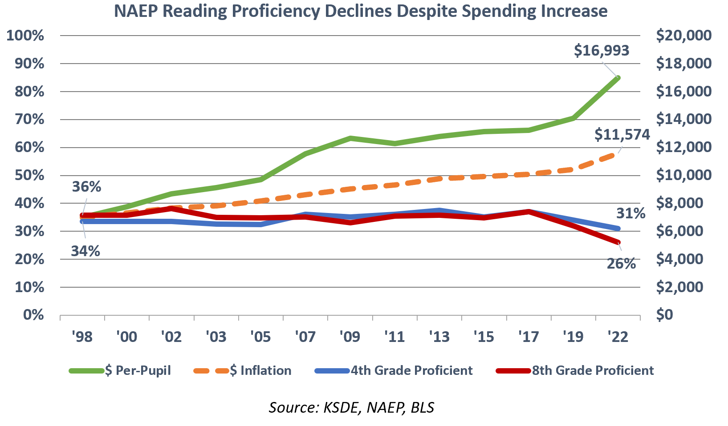
Government-provided data: spending up, achievement down

Slide 6
ACT college-ready in English, Reading, Math and Science
Source: ACT, Kansas Dept. of Education, Bureau of Labor Statistics Consumer Price Index for Midwest Cities on fiscal basis.

Slide 7
State assessment only valid since 2015

Slide 8
Be aware of large achievement gaps

Slide 9
K.S.A. 72-1163 legal requirements
Each year the board of education of a school district shall conduct an assessment of the educational needs of each attendance center in the district. Such assessment shall be published on the school district's website. Information obtained from such needs assessment shall be used by the board when approving the budget of the school district to ensure improvement in student academic performance.

Slide 10
You must answer three questions (each school)
What are the barriers preventing students from being proficient in reading and math?
What budgetary changes are needed to overcome the barriers?
With changes implemented, how many years to proficient (and/or below grade level)?

Slide 11
Most districts do not follow BNA law
Dodge City: In 2022, district summary only; answers to Question #2 do not address the barriers identified in Question #1, and the response to Question #3 (“more than five years”) is not within the spirit of the law. In 2023, the district admits that board members did not attend meetings.
Some districts don’t answer the required questions.
Many districts contend board members don’t have to participate, just review the staff-prepared reports.

Slide 12
Part 1:
Take Charge of the BNA Process

Slide 13
BNA is a legal obligation for board members
Tell district staff to schedule meetings with each school, provide supplies and support as directed.
District staff may attend to observe, but board members run the meetings.
Require attendance for teachers and principals?

Slide 14
Discuss BNA meeting parameters in advance
Don’t let ‘board policy’ get in the way. Assert your legal obligation to participate.
No board member should be restricted in asking questions of staff.
Encourage public to attend and observe.

Slide 15
Setting goals for the district leadership team
KSDE target is 75% proficient (Levels 3 and 4).
Eat the elephant one bite at a time.
  Be brutally realistic – you won’t get there in a few years.
  Allow for achievement gaps; set goals for each primary cohort.
    Low-income (free and reduced)
    Not low-income (self-pay lunch)
  Allow for grade-level and subject proficiency variances

Slide 16
Setting goals for the district leadership team
Achievement typically drops precipitously in elementary school and students never catch up – districts must eliminate that inflection point.

Slide 17
Setting goals for the district leadership team
Board members aren’t expected to have the answers, but you must ask the tough questions.
  Why are the causes of achievement declines in early grades?
  What basic elements are missing in the curriculum?
  What’s getting in the way (DEI, for example) and how do we remove those barriers?
  Wabaunsee’s DEI solution
No excuses – it’s management’s job to create a plan to produce required outcomes within existing resources.

Slide 18
Part 2:
Running Productive Meetings

Slide 19
Q1: Qualities of legitimate barriers
Identify challenges that district staff can address. This is a problem-solving exercise, not ‘Festivus.’
  No generic barriers like ‘money’ and ‘staffing.’
  No political statements.
Be wary of topics over which schools have little control; focus on what you can do to ameliorate an issue.
  Early childhood needs
  Mental health (is DEI making it worse?)
  Lack of parental involvement

Slide 20
Q1: Qualities of legitimate barriers
Encourage building staff to think ahead to Q2. Barriers should be actionable within existing resources.
Ask probing questions. What’s the basis for this as a barrier?
Is there strong consensus on this barrier within the school?
Emerson Elementary story – is the staff a barrier?

Slide 21
Q1: Test the barriers; connect the dots
Repeatedly emphasize that you’re working together to build a student achievement plan.
Tell district staff to prepare a specific achievement report for each school. Do barriers reflect the severity of the issue?

Slide 22
Q1: Prioritize the barriers
Encourage staff to identify barriers to develop buy-in. List everything for staff to see.
Then collectively agree on which are the top 3 or top 5 barriers to address with budgetary changes.

Slide 23
Q2: Legitimate budgetary changes
This is about resource allocation, not a wish list for more $.
Instruction – costs associated with the direct interaction between students and teachers – is “the most important part of the education program, the very foundation on which everything else is built. If this function fails to perform at the needed level, the whole educational program is doomed to failure regardless of how well the other functions perform.”
    KSDE Accounting Manual

Slide 24
Q2: Legitimate budgetary changes
Staff needs to know what is available in the 2024 budget:
  USD 457: $19,204 per student total; $16,382 operating
  USD 274: $20,018 per student total; $17,845 operating
  USD 480: $19,742 per student total; $15,328 operating
Budgets should be about priorities…what can be cut back or eliminated to remove barriers?
Hard numbers aren’t necessary yet. Focus on the concepts with building staff; district staff can run numbers later.

Slide 25
Q2: Legitimate budgetary changes
Use BNA meetings to develop lists of possibilities.
Write ideas on big Post-It sheets for all to see.
Encourage building staff to email with additional thoughts and ideas after the meetings.
Answers to Question #3 will be addressed with district staff at subsequent meetings.

Slide 26
Part 3:
Follow-Up Discussions with District Staff

Slide 27
BNA process tells you if you have the right leadership team
BNA purpose: put a plan in place to achieve specific achievement goals with existing resources.
Allocate staff and resources to achieve the plan. Don’t try to fit the plan in existing structure; that’s trying to disprove Einstein’s definition of insanity.
Emphasize the key principle. Improving outcomes is #1 priority. That means nothing gets in the way…not DEI, extracurriculars, or existing management structure.

Slide 28
Board-driven process that lays out district staff primary responsibilities
Staff must provide within the board-determined timeframe:
  Calculate costs to address each barrier.
  Provide commentary on barriers identified by building staff.
  Prioritize options to shift resources to address barriers.
One week for board study, then a series of meetings to review with staff and select the options to address achievement barriers.

Slide 29
Board-driven process that lays out primary responsibilities for district staff
Budgets should fulfill Instruction needs for improving achievement. Then allocate remaining resources as needed.
Cost-saving opportunities are everywhere:
  What happens if we don’t spend this (dues, travel, etc.)?
  Reduce costs with outsourcing & cross-district service-sharing.
  Are we losing money on food service?
  Are we fully utilizing bulk purchasing options?

Slide 30
Dealing with objections
Keep the focus on the BNA purpose.
Ask questions like…Is (doing this or avoiding that) more important than improving achievement?

Slide 31
Part 4:
Passing the Budget & Monthly Updates

Slide 32
Public budget hearing
Keep the focus on the BNA process. The budget is built around targeted student achievement gains.
Achievement handout for the public. The budget is designed to go from (A) specific 2023 state assessment results to (B) specific goals by (C) the end of a specific school year.
Emphasize the major barriers identified and the related changes proposed in the budget.

Slide 33
Monthly progress reports
Progress reports from at least one elementary, middle school, and high school principal at each board meeting.
  What are we doing differently, and why?
  How are we measuring progress?
  Student and staff reactions.
  How can parents and community leaders help?
Educate the community; civic clubs, chamber of commerce.

